Slide 1
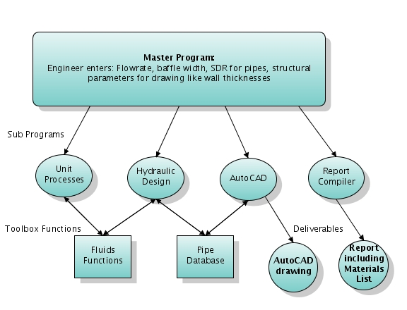

Slide 2
Design: MathCAD

Slide 3
AUTOMATED PLANT DESIGN
Use MathCAD to automate design of AguaClara plants.
Program outputs essential to plant design, as well as a text file for AutoCAD drawing.
Future plans: Design tool will be online, to meet our goal of open source engineering.

Slide 4
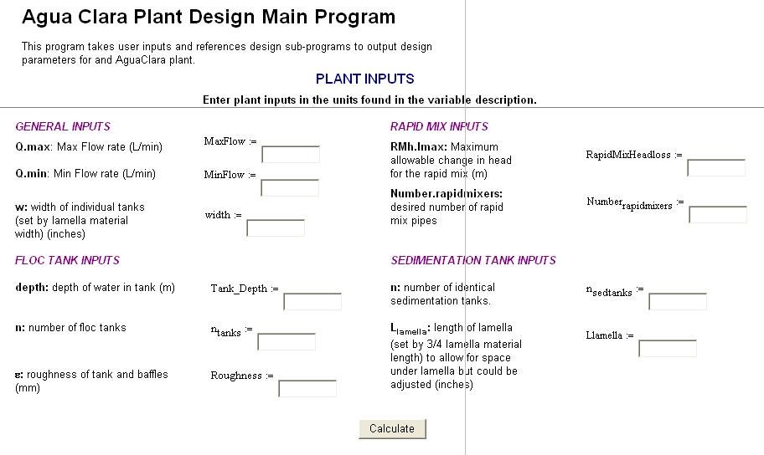

Automated Plant Design Program
2007 Version
2000
1
1000
1
32
2
1
1
54
1

Slide 5
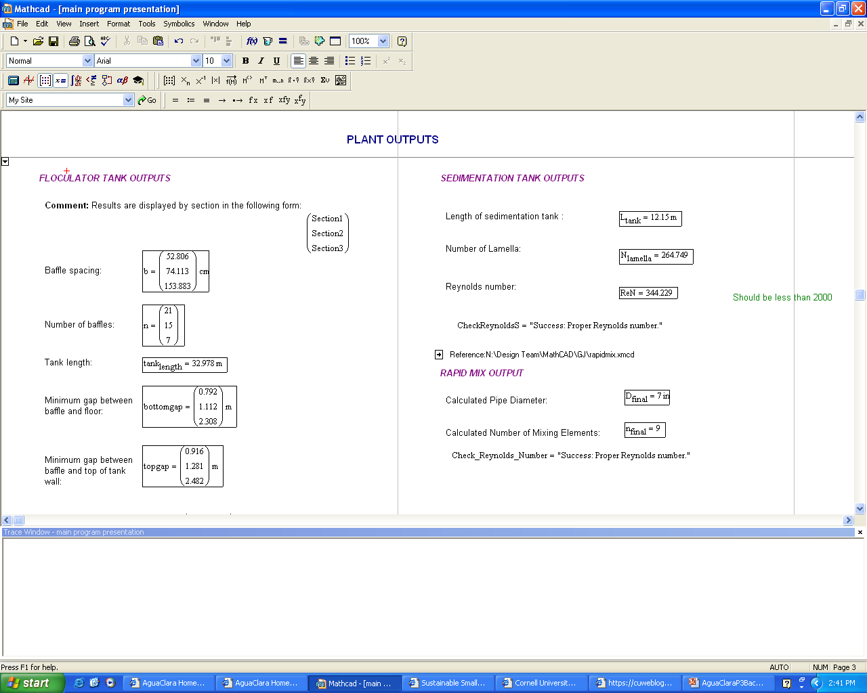
Automated Plant Design Program
2007 Output parameters

Slide 6
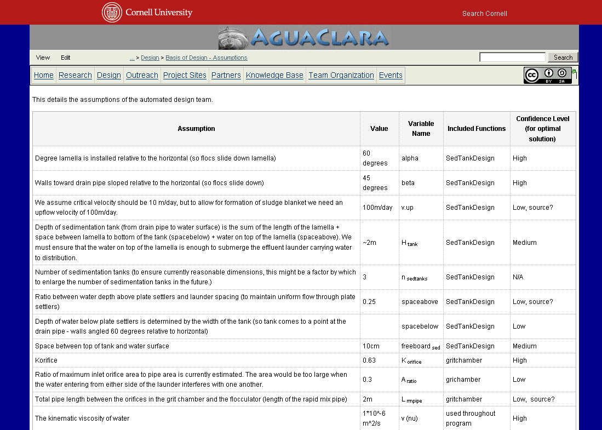
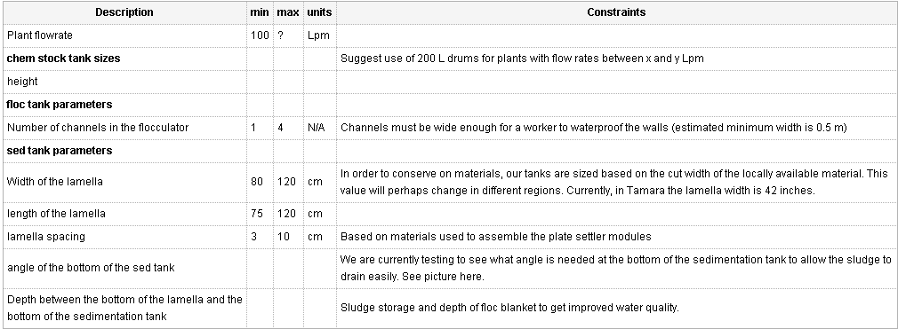
Current Progress
What decisions should be left up to the user?
Number of Channels in Flocculator
Size of the Bodega
        https://confluence.cornell.edu/display/AGUACLARA/Basis+of+Design+-+Assumptions

Slide 7
AUTOMATED PLANT DESIGN
Using the output parameters from the MathCAD design algorithms, we will generate scripts that will draw a model of the water treatment plant in AutoCAD
The purpose of this tool is to give engineers a visual representation of what the size and layout of their proposed plant will look like before they begin construction

